Slide 1
Optimizing for More Reliable Outcomes
Jeff Megar
VP, Client Portfolio Solutions
May 1, 2025
Confidential and Proprietary – For Institutional Use Only © 2025 New Frontier Advisors, LLC.
Notes:
Today is about enhancing what you already do with New Frontier. We'll explore how our optimization-driven core portfolios — and our scalable customization tools — can help you better serve your clients and grow your practice.
This isn’t about adding complexity — it’s about making it easier to deliver better outcomes consistently, at scale.

Slide 2
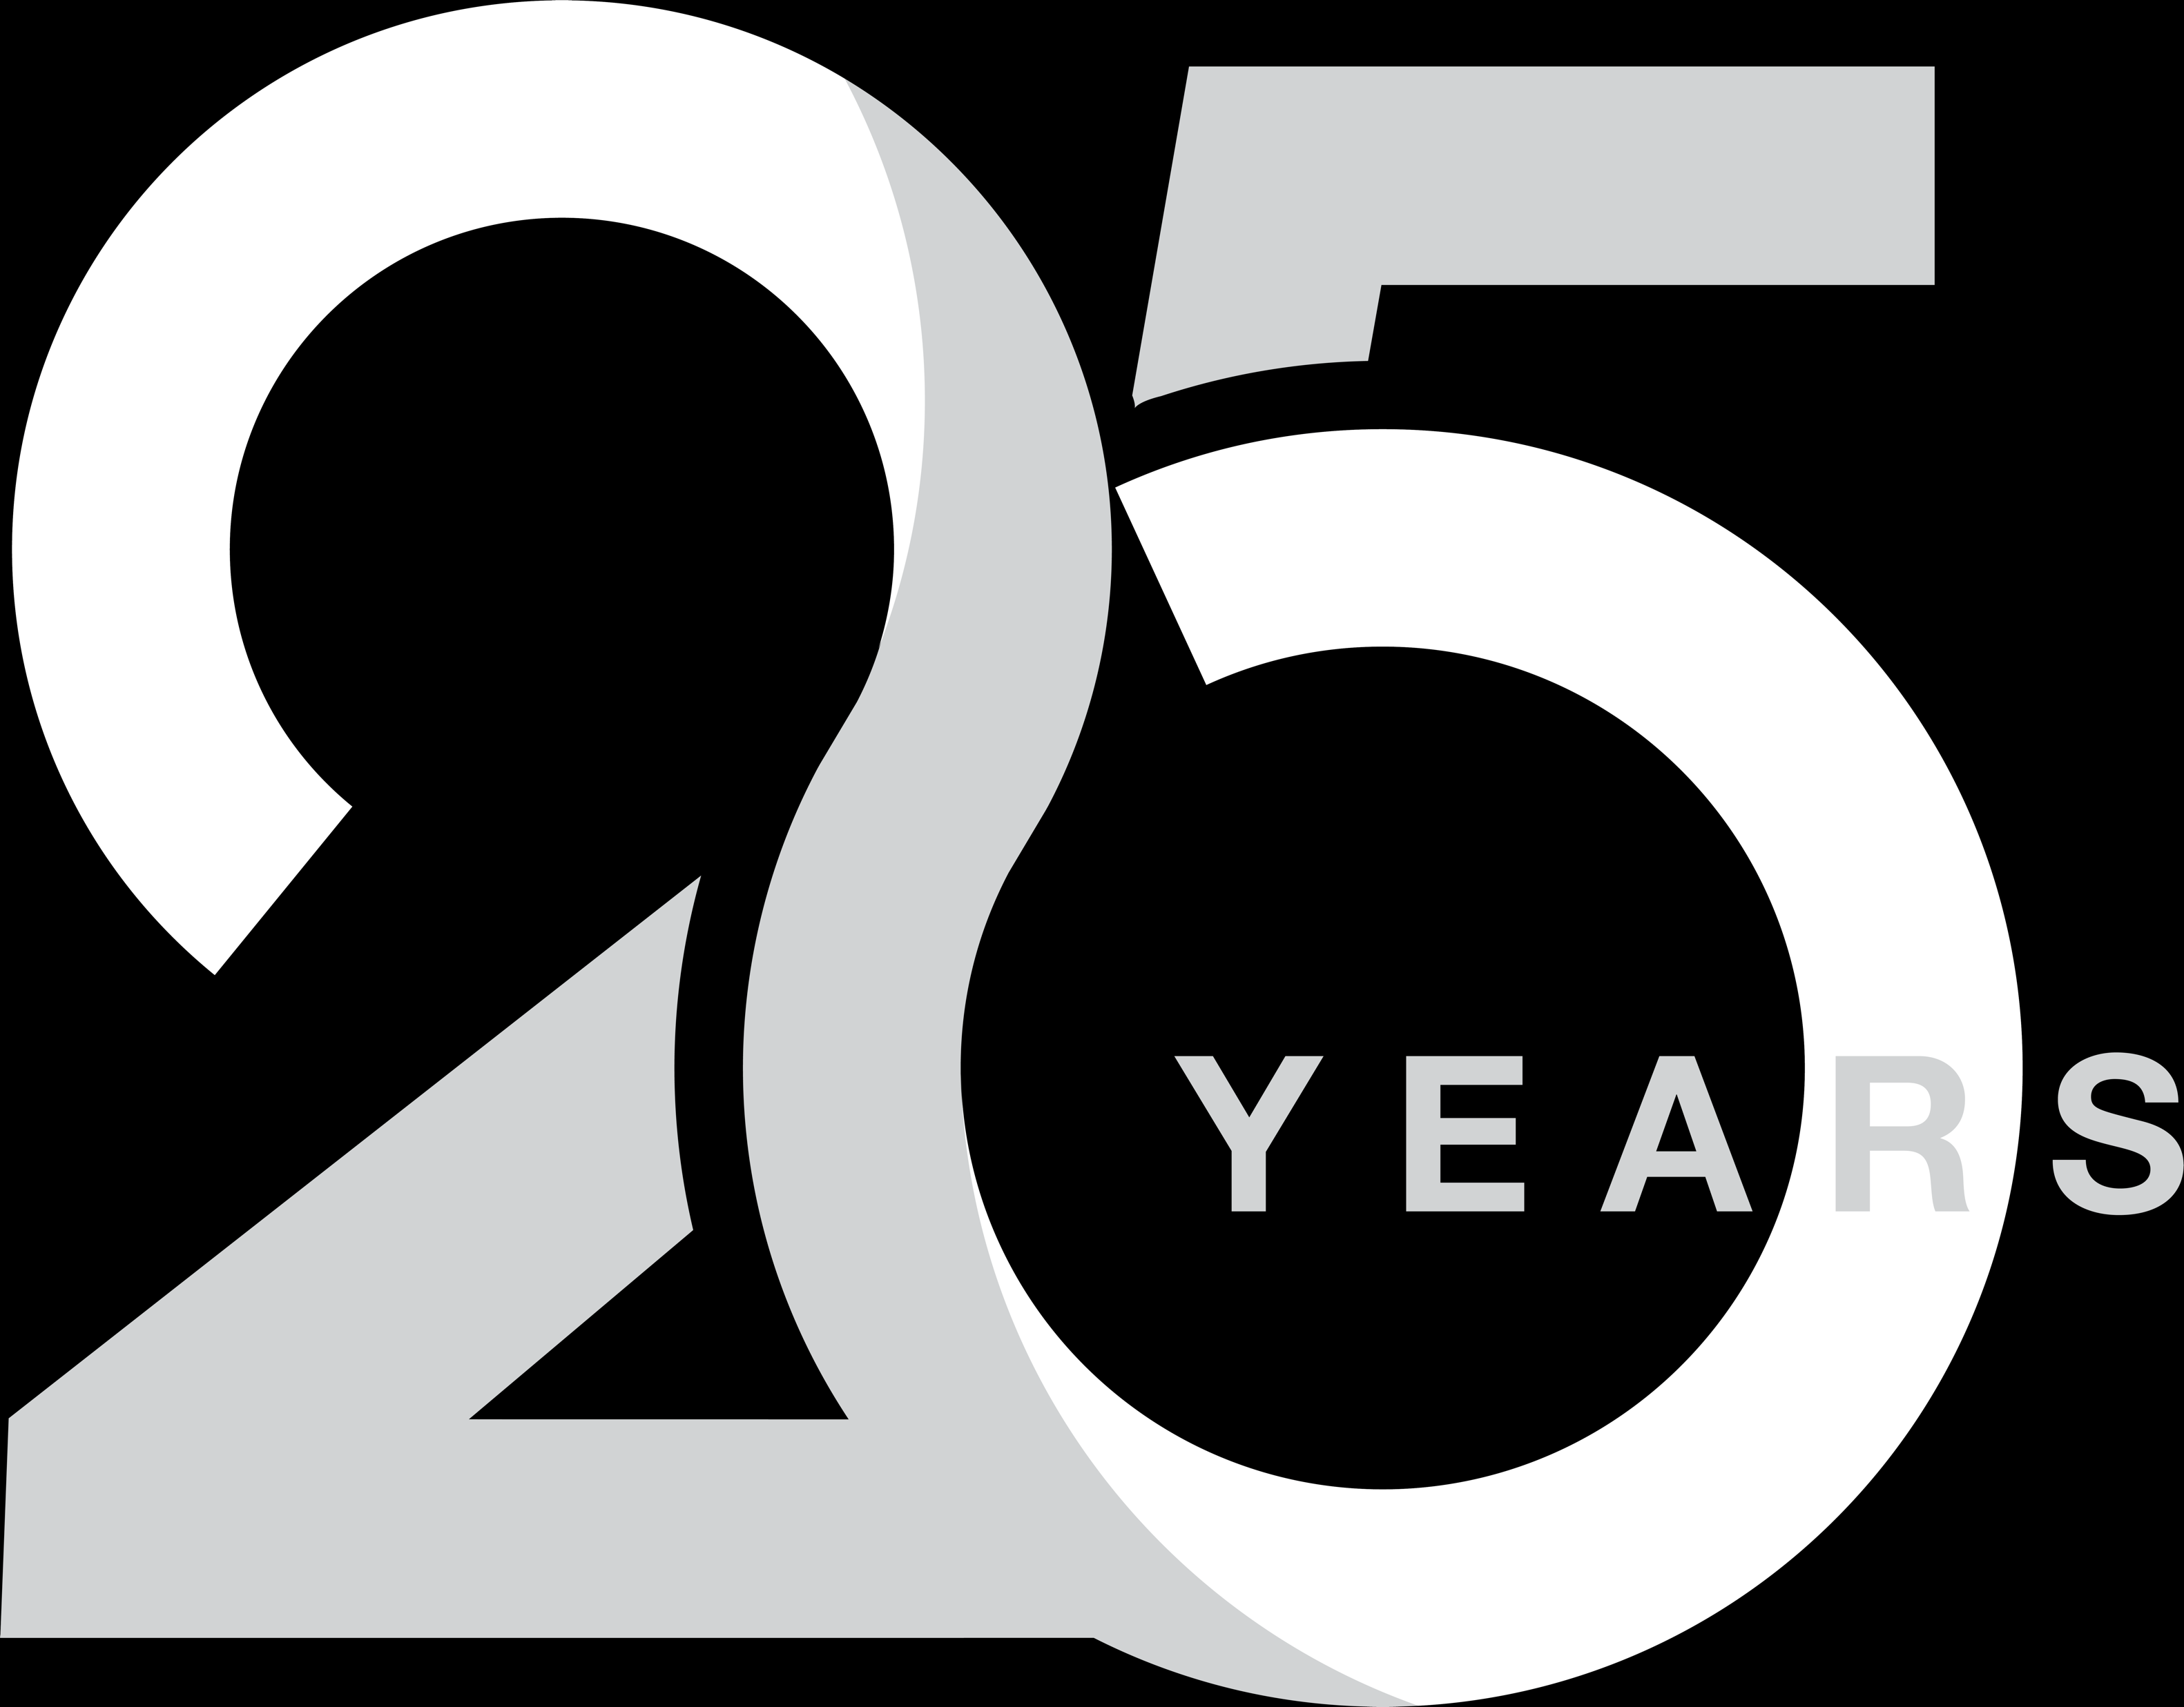
New Frontier: Innovation in Portfolio Optimization
Founded in 1999 on groundbreaking research in portfolio optimization.
Co-founders Dr. Richard Michaud and Robert Michaud — 4 patents earned for portfolio optimization and rebalancing
Independent — no proprietary ETFs, no product conflicts.
Serving institutional investors, 3000 financial advisors and their clients
ETF strategist pioneer – 20-year track record
60+ academic and professional journal articles/manuscripts published
2
Notes:
At New Frontier, our mission has always been about advancing portfolio management — moving beyond traditional models to truly address uncertainty and deliver better outcomes for investors.
We're independent — our only focus is building portfolios that align with real client needs.

Slide 3
New Frontier Model Portfolios
Global Core ETF Portfolios
Global Tax-Sensitive ETF Portfolios
U.S. Core
ETF Portfolios
New Frontier Kraneshares™ Core
+ Alts Portfolios
Multi-Asset Income ETF Portfolios
Focus: Long-term total return
Global Core ETF 20/80 Portfolio
Global Core ETF 40/60 Portfolio
Global Core ETF 60/40 Portfolio
Global Core ETF 75/25 Portfolio
Global Core ETF 90/10 Portfolio
Global Core ETF 100/0 Portfolio
Focus: Enhanced after-tax return
Tax-Sensitive ETF 20/80 Portfolio
Tax-Sensitive ETF 40/60 Portfolio
Tax-Sensitive ETF 60/40 Portfolio
Tax-Sensitive ETF 75/25 Portfolio
Tax-Sensitive ETF 90/10 Portfolio
Tax-Sensitive ETF 100/0 Portfolio
Focus: Long-term total return
U.S. Core ETF
20/80 Portfolio
U.S. Core ETF
40/60 Portfolio
U.S. Core ETF
60/40 Portfolio
U.S. Core ETF
75/25 Portfolio
U.S. Core ETF
90/10 Portfolio
U.S. Core ETF
100/0 Portfolio
Focus: Long-term total return
Core + Alts Conservative Portfolio
Core + Alts Moderate Conservative Portfolio
Core + Alts Moderate Portfolio
Core + Alts Growth Portfolio
Core + Alts Moderate Aggressive Portfolio
Core + Alts Aggressive Portfolio
Focus: Enhanced income relative to capital growth
Multi-Asset Income ETF 40/60 Portfolio
Multi-Asset Income ETF 60/40 Portfolio
Multi-Asset Income ETF 75/25 Portfolio
Wealth Management Solutions: Portfolio Customization
Personalized, intelligently risk- managed portfolio solutions available across all risk levels and investment objectives
Notes:
Our model portfolios are designed to be complete core solutions — diversified globally, tailored by risk profile, and adaptive to new information. They allow you to deliver consistent, scalable investment experiences to a wide range of client types

Slide 4
The New Frontier Advantage
Innovative, Proven Optimization
New Frontier is recognized for inventing a uniquely effective and multi-patented form of portfolio optimization.
Daily Portfolio Monitoring
Portfolios are monitored daily and our technology alerts us when it may be time to rebalance.
Intelligent RebalancingTM
Our patented rebalancing test enhances investment value by trading only when statistically likely to benefit investors.
Tax-Smart Portfolio Optimization
We choose tax-efficient, low-cost ETFs and optimize their unique features to maximize expected after-tax wealth.
Best-in-Class ETFs / Nonproprietary ETFs
As an independent asset manager, we choose the most suitable ETFs, regardless of fund family.
20-Year Track Record
We have consistently managed risk, adapted to evolving markets, and delivered stronger risk-adjusted returns than traditional approaches.
4
4

Slide 5
Our Investment Philosophy
Intelligent Diversification across securities, asset classes, geographies, risk factors, and time.
Managed Costs — low-turnover, low-cost ETFs, thoughtful tax management.
Strategic, Not Static — use real data, avoid speculation and market timing.
Optimization-Centric — maximize return relative to risk, incorporate meaningful new information, stay aligned with the investment objective
Build customized portfolios designed to address market uncertainty. Our portfolios are closely aligned to client investment objectives than traditional approaches.
Notes:
Our philosophy blends the best of academic rigor with real-world practicality. Intelligent diversification, disciplined cost management, and a commitment to evolving portfolios based on new, meaningful information — not market noise

Slide 6
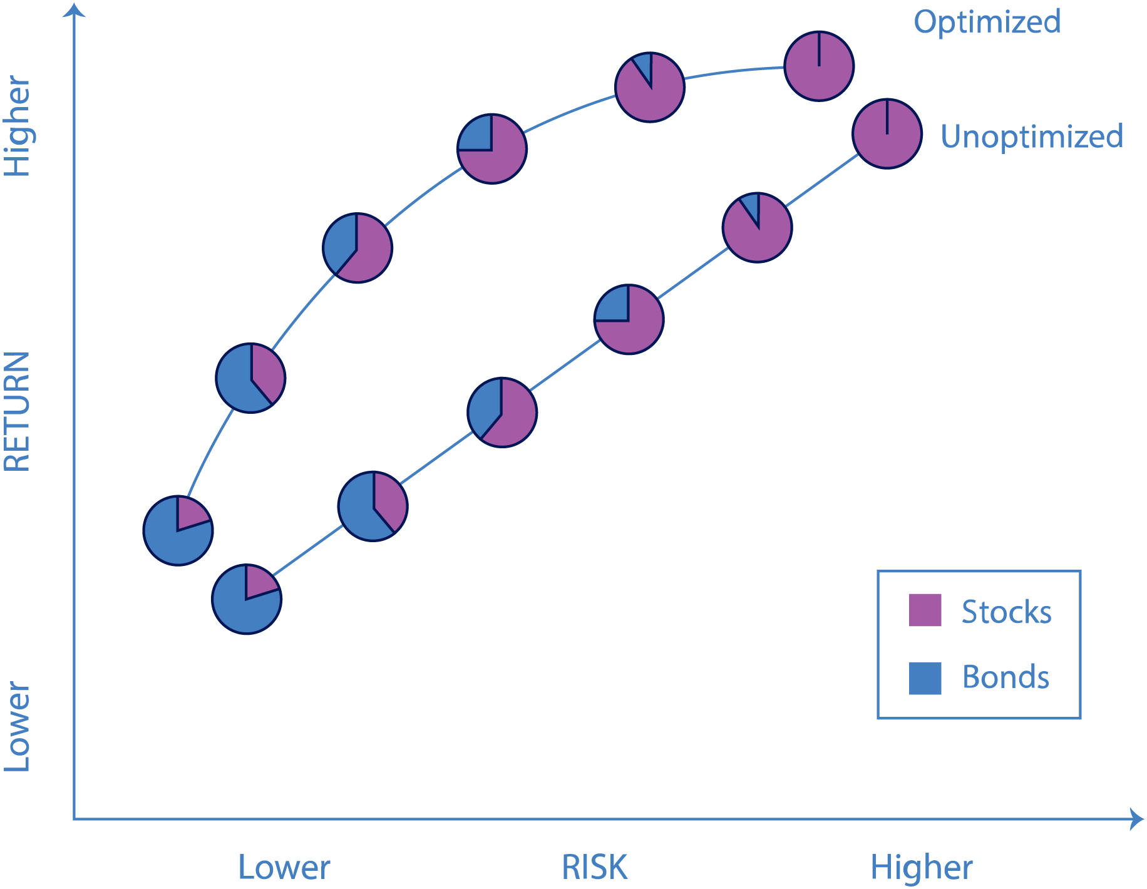
Why Optimize?
Robust risk management
Better alignment with client goals
No missed opportunities — maximize return for each level of risk
Resilient portfolios that adapt to meaningful changes in the market environment.
Optimization offers the potential for higher returns with lower risk.
For illustrative purposes only.
Notes:
Optimization is about more than just seeking risk-adjusted returns — it's about building portfolios that smartly manage risk and adapt to real-world conditions. Without optimization, portfolios may drift inefficiently, missing opportunities or exposing clients to unnecessary risk.
The efficient frontier identifies the optimal portfolio allocation that maximizes returns for a given level of risk while the unoptimized portfolios may result in lost opportunity for an investor.
The efficient frontier identifies the optimal portfolio allocation that maximizes returns for a given level of risk while the unoptimized portfolios may result in lost opportunity for an investor.
Portfolio optimization provides two advantages: 1) intuitively better fit by adjusting exposures within asset classes to match investment goals; 2) Efficiently improve risk-adjusted returns by taking advantage of asset relationships or asset correlations. Extract the full potential of the market.
At New Frontier, our portfolios are built to adapt to uncertainty and respond to relevant market shifts.
This allows for a greater likelihood of achieving the investment objective and a smoother investment journey over the long term.

Slide 7
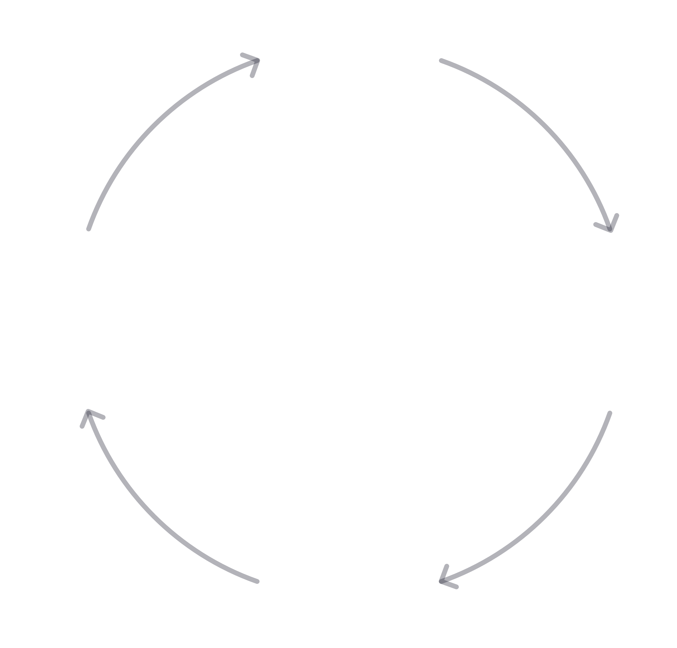
Independently select best in class ETFs for investment goals
1
New Frontier Investment Process
Monitor and rebalance portfolio when it statistically deviates from goal
4
2
Dynamically estimate risk and return using advanced statistical methods
3
Optimize for an uncertain future using thousands of market scenarios

Slide 8
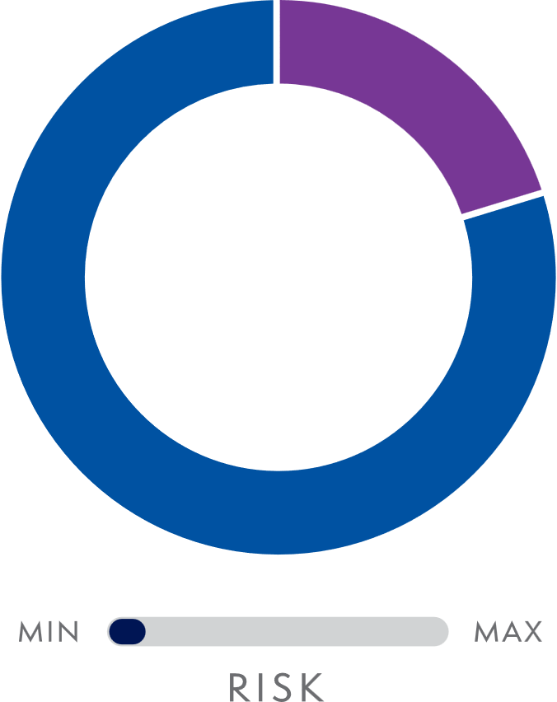
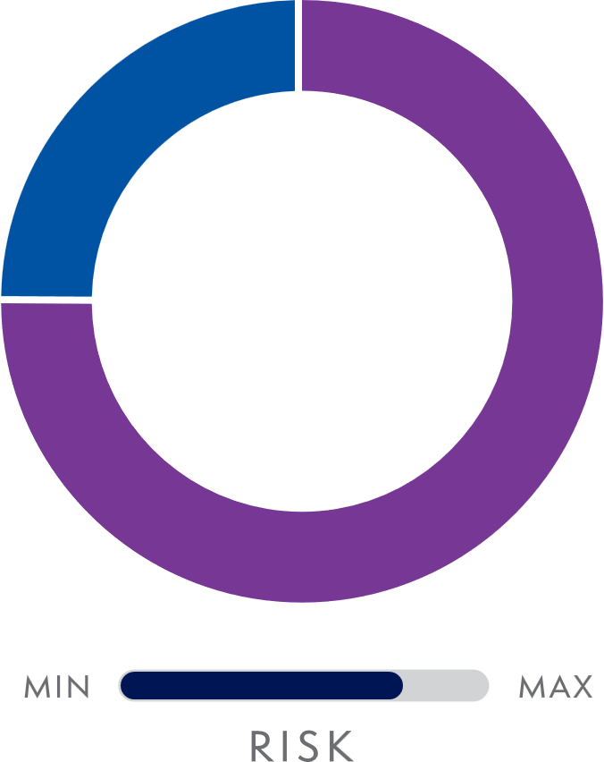
Traditional Portfolios
Static Security Selection
Conservative and aggressive investors hold the same types of stocks and bonds — in the same ratios — regardless of their investment objectives.
20/80
75/25
STOCKS
BONDS
For illustrative purposes only.
Notes:
Static mix of stocks and bonds and adjust risk by changing the asset allocation.
Conservative to aggressive investors hold the same stocks and bonds—in the same ratios—without consideration of their investment objectives.
The problem with most traditional portfolios is that conservative and aggressive investors hold the same types of stocks and bonds—in the same ratios—regardless of the client’s investment objectives.

Slide 9
Tailored portfolios for all risk profiles
Dynamic Security Selection
New Frontier optimizes the whole portfolio by dynamically adjusting both the asset allocation and underlying holdings. This results in portfolios that are more closely aligned with investor goals.
20/80
75/25
Conservative portfolios hold lower risk, defensive asset classes
Aggressive portfolios hold asset classes that pursue higher returns
STOCKS
BONDS
For illustrative purposes only.
Notes:
Identify specific asset classes relative to the investment goal
Ex. – Min vol is an appropriate equity exposure for a conservative investor but probably not so for an aggressive investor.
Ex. – Investment grade bonds or MBS might not be appropriate for aggressive investors, but are appropriate for conservative investors

Slide 10
Unified Investment Process
All of our portfolios use New Frontier’s four-step investment process, which builds a customized mix of ETFs to meet each investor’s risk tolerance and investment objectives.
1
2
3
4
Select Asset Universe and ETFs
Estimate Risk and Return
Construct Portfolios
Monitor and Rebalance
Investment Objective
Total Return Optimization
Total Return Optimization
After-Tax
Optimization
Income-Seeking
Optimization
Investment Strategy
Global Core ETF Portfolios
U.S. Core ETF Portfolios
Tax-Sensitive ETF Portfolios
Multi-Asset Income ETF Portfolios

Slide 11
New Frontier Model Portfolios
Global Core ETF Portfolios
Global Tax-Sensitive ETF Portfolios
U.S. Core
ETF Portfolios
New Frontier Kraneshares™ Core
+ Alts Portfolios
Multi-Asset Income ETF Portfolios
Focus: Long-term total return
Global Core ETF 20/80 Portfolio
Global Core ETF 40/60 Portfolio
Global Core ETF 60/40 Portfolio
Global Core ETF 75/25 Portfolio
Global Core ETF 90/10 Portfolio
Global Core ETF 100/0 Portfolio
Focus: Enhanced after-tax return
Tax-Sensitive ETF 20/80 Portfolio
Tax-Sensitive ETF 40/60 Portfolio
Tax-Sensitive ETF 60/40 Portfolio
Tax-Sensitive ETF 75/25 Portfolio
Tax-Sensitive ETF 90/10 Portfolio
Tax-Sensitive ETF 100/0 Portfolio
Focus: Long-term total return
U.S. Core ETF
20/80 Portfolio
U.S. Core ETF
40/60 Portfolio
U.S. Core ETF
60/40 Portfolio
U.S. Core ETF
75/25 Portfolio
U.S. Core ETF
90/10 Portfolio
U.S. Core ETF
100/0 Portfolio
Focus: Long-term total return
Core + Alts Conservative Portfolio
Core + Alts Moderate Conservative Portfolio
Core + Alts Moderate Portfolio
Core + Alts Growth Portfolio
Core + Alts Moderate Aggressive Portfolio
Core + Alts Aggressive Portfolio
Focus: Enhanced income relative to capital growth
Multi-Asset Income ETF 40/60 Portfolio
Multi-Asset Income ETF 60/40 Portfolio
Multi-Asset Income ETF 75/25 Portfolio
Wealth Management Solutions: Portfolio Customization
Personalized, intelligently risk- managed portfolio solutions available across all risk levels and investment objectives
Notes:
Our model portfolios are designed to be complete core solutions — diversified globally, tailored by risk profile, and adaptive to new information. They allow you to deliver consistent, scalable investment experiences to a wide range of client types

Slide 12
How to Use New Frontier
Stand Alone Strategy
New Frontier portfolios are designed to be complete portfolios
Traditionally used with smaller accounts
Multi Manager Account
New Frontier portfolios could be used as a core position
Allows advisor to express personal investment thesis with a solid core component
Customized Solutions
New Frontier can customize a portfolio relative to your client's investment objective and risk profile
12
12

Slide 13
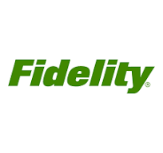
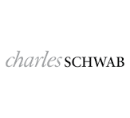
Global Core, Global Tax Sensitive and Core + A well diversified portfolio for varying investment objectives (A complete portfolio solution)
Aggressive Moderate Conservative
Diversified ETF Providers
Diversified ETF Providers
Notes:
US large cap and small cap, value and growth – global diversification, treasuries, corporate debt

Slide 14
Our strategies are used as the stable core of an MSA Flexibility Around a Strong Core
Aggressive Moderate Conservative
New Frontier Global Standard
New Frontier Global Standard
New Frontier Global Standard
Equity Enhancer
Risk Mitigator
Equity Enhancer
Risk Mitigator
Equity Enhancer
Risk Mitigator
Fixed Income Enhancer
Fixed Income Enhancer
Fixed Income Enhancer
Satellite positions offer you
Ability to express an investment opinion
Ability to change portfolio objective while maintaining a core position – less to trade
New Frontier strategies offer you
Stability
Diversification
Risk Mitigation

Slide 15
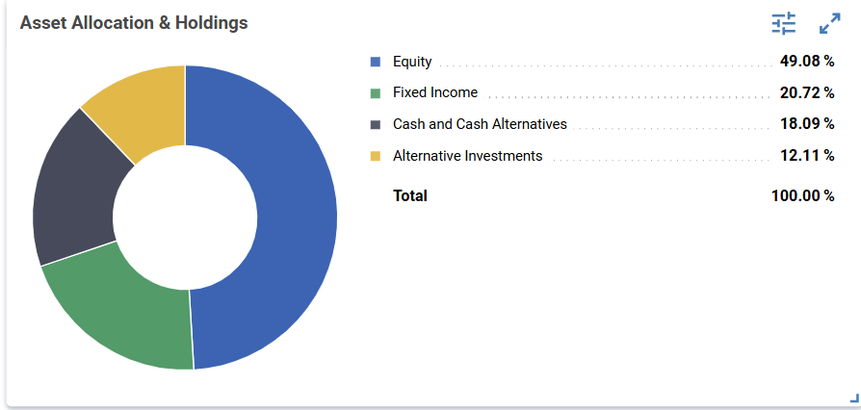
Multi Manager Account using Global Standard- Example
 | Portfolio Weight
New Frontier Global Standard Profile 3 | 50%
Tactical Equity Strategy | 15%
Tactical Fixed Income Strategy | 10%
Thematic Strategy | 15%
Alternatives Strategy | 10%
As of 3/31/2025 Gross of fees
As of 4/24/2025
* Data Source: Portfolio Engine
For Illustrative Purpose only
Notes:
AssetMark Clients

Slide 16
Multi-Asset Income
Multi Asset Income is a perfect solution for many investor’s needs

Slide 17
Multi-Asset Income Income with growth solutions for varying risk profiles (A complete portfolio solution)
Aggressive Moderate Conservative
Diversified ETF Providers
Diversified ETF Providers
Notes:
WE can break this exposure down further – Preferreds, dividends, high yield, convertables, floating rate etc.

Slide 18
Multi-Asset Income
Multi-Asset Income could be pared with other income focused strategies for a slightly more aggressive or sophisticated investor

Slide 19
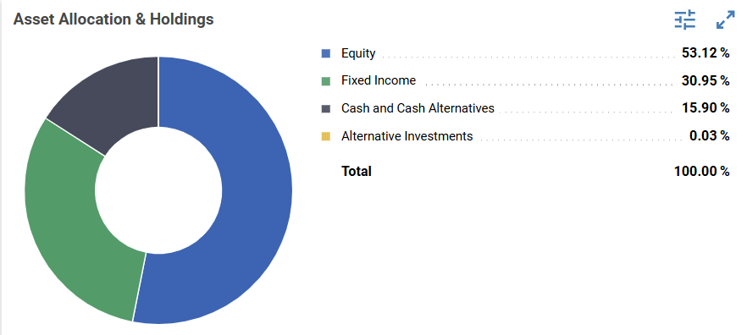
Multi Manager Account using Multi Asset Income- Example
 | Portfolio Weight
New Frontier Multi-Asset Profile 4 | 65%
Tactical Fixed Income Strategy | 20%
High Income Strategy | 15%
Estimated yield of 5.1%*
As of 3/31/2025 Gross of fees
As of 4/28/2025
* Data Source: Portfolio Engine
Notes:
AssetMark Clients

Slide 20
Building Custom Optimized Portfolios
Align client objectives with portfolio construction.
Model tax-aware transitions.
Maintain optimization discipline even with custom needs.
Notes:
Now we'll show you how easily you can build customized, optimized portfolios with FrontierOne — maintaining all the integrity of our optimization approach while addressing client-specific needs. Today, before the new product launches, we can analyze, build, optimize, transition, and manage a custom portfolio for clients today.

Slide 21
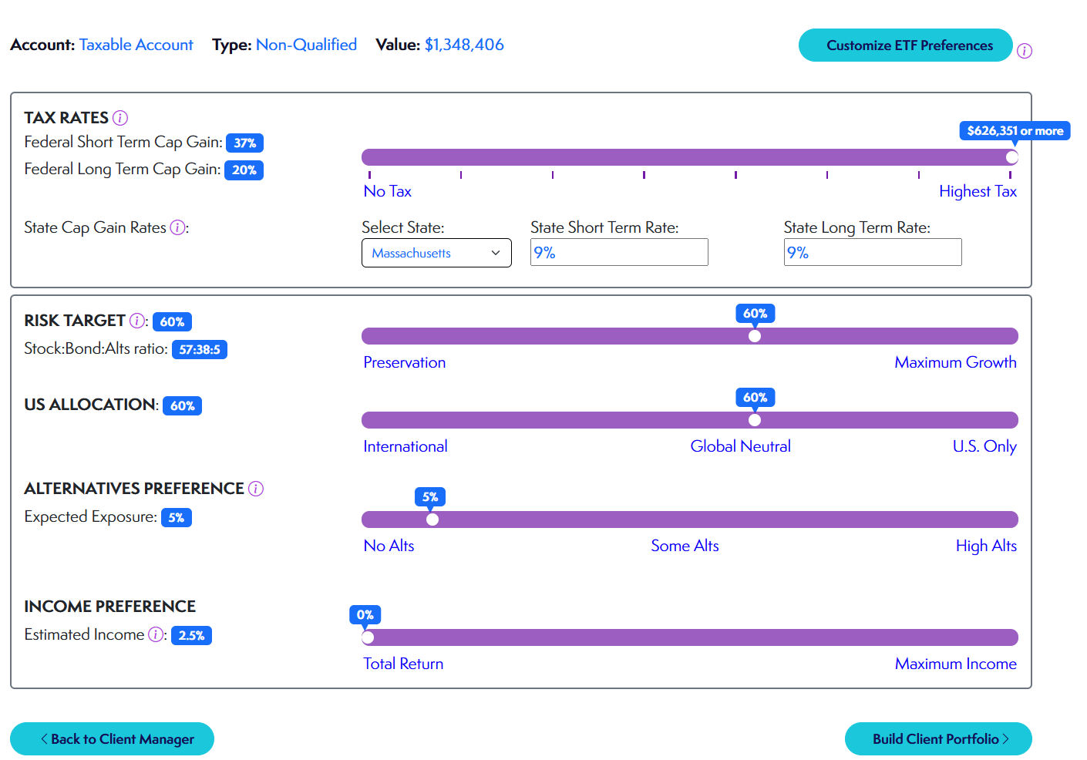
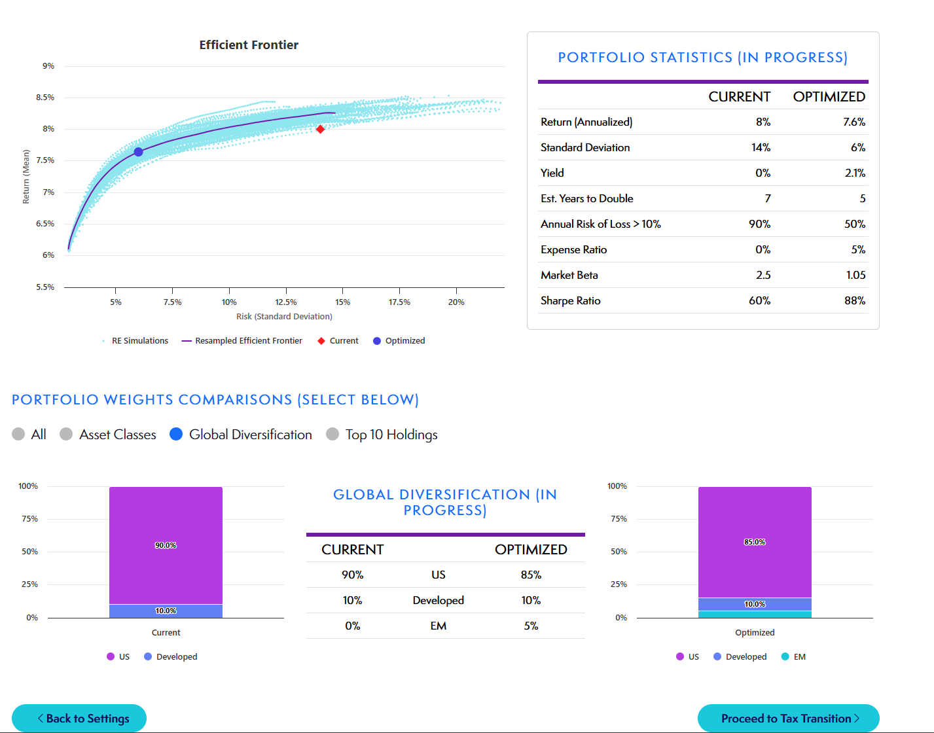
Customized Portfolio Construction in Action
Confidential and Proprietary – For Institutional Use Only © 2025 New Frontier Advisors, LLC.
Notes:
This screen shows how FrontierOne allows an advisor to build a fully custom portfolio tailored to a client’s goals, tax considerations, and household context.
On the left side, you can see the advisor entering key inputs: account type, tax rates, risk target, U.S. vs. global allocation, preferences for alternatives and income, and the ability to customize ETF exposure based on firm or client needs.
Once those preferences are set, the system runs a full optimization—and on the right side, you can see the results: an optimized portfolio positioned on the Efficient Frontier, with improved performance and risk metrics compared to the current holdings.
We also show detailed stats making it easy for the advisor to explain the benefits of the proposed portfolio to the client.
This is where intelligent customization meets institutional discipline—and where we bridge the gap between client intent and portfolio design.

Slide 22
Why New Frontier?
Confidence
New Frontier is recognized for inventing a uniquely effective and multi-patented form of portfolio optimization.
Stability
Portfolios are monitored daily, and our technology alerts us when it may be time to rebalance.
Consistency
Consistent methodical process across all strategies
Risk focused process
Academically based, statistically driven investment process
Independent
As an independent asset manager, we choose the most suitable ETFs, regardless of fund family.
20 - Year Track Record
We have consistently managed risk, adapted to evolving markets, and delivered stronger risk-adjusted returns than traditional approaches.
22
22

Slide 23
Why New Frontier?
We are committed to providing market-adaptive, risk-managed portfolios that align with your clients’ investment objectives.
Portfolios are optimized to produce smoother, more reliable long-term outcomes.
Innovative, Proven Optimization
Daily Portfolio Monitoring
Intelligent RebalancingTM
Tax-Smart Portfolio Optimization
Best-in-Class ETFs / Nonproprietary ETFs
20-Year Track Record
23
Notes:
Update with new icons

Slide 24
Let’s Build Your Practice Together
Schedule a 1:1 with Jeff
Explore how to apply New Frontier’s solutions across your client base
Optimize client outcomes — and optimize your business
Notes:
We’re here to help you succeed — not just with better investment strategies, but as a true partner in growing your practice. Schedule time after today’s session so we can customize a plan that fits your business goals.

Slide 25
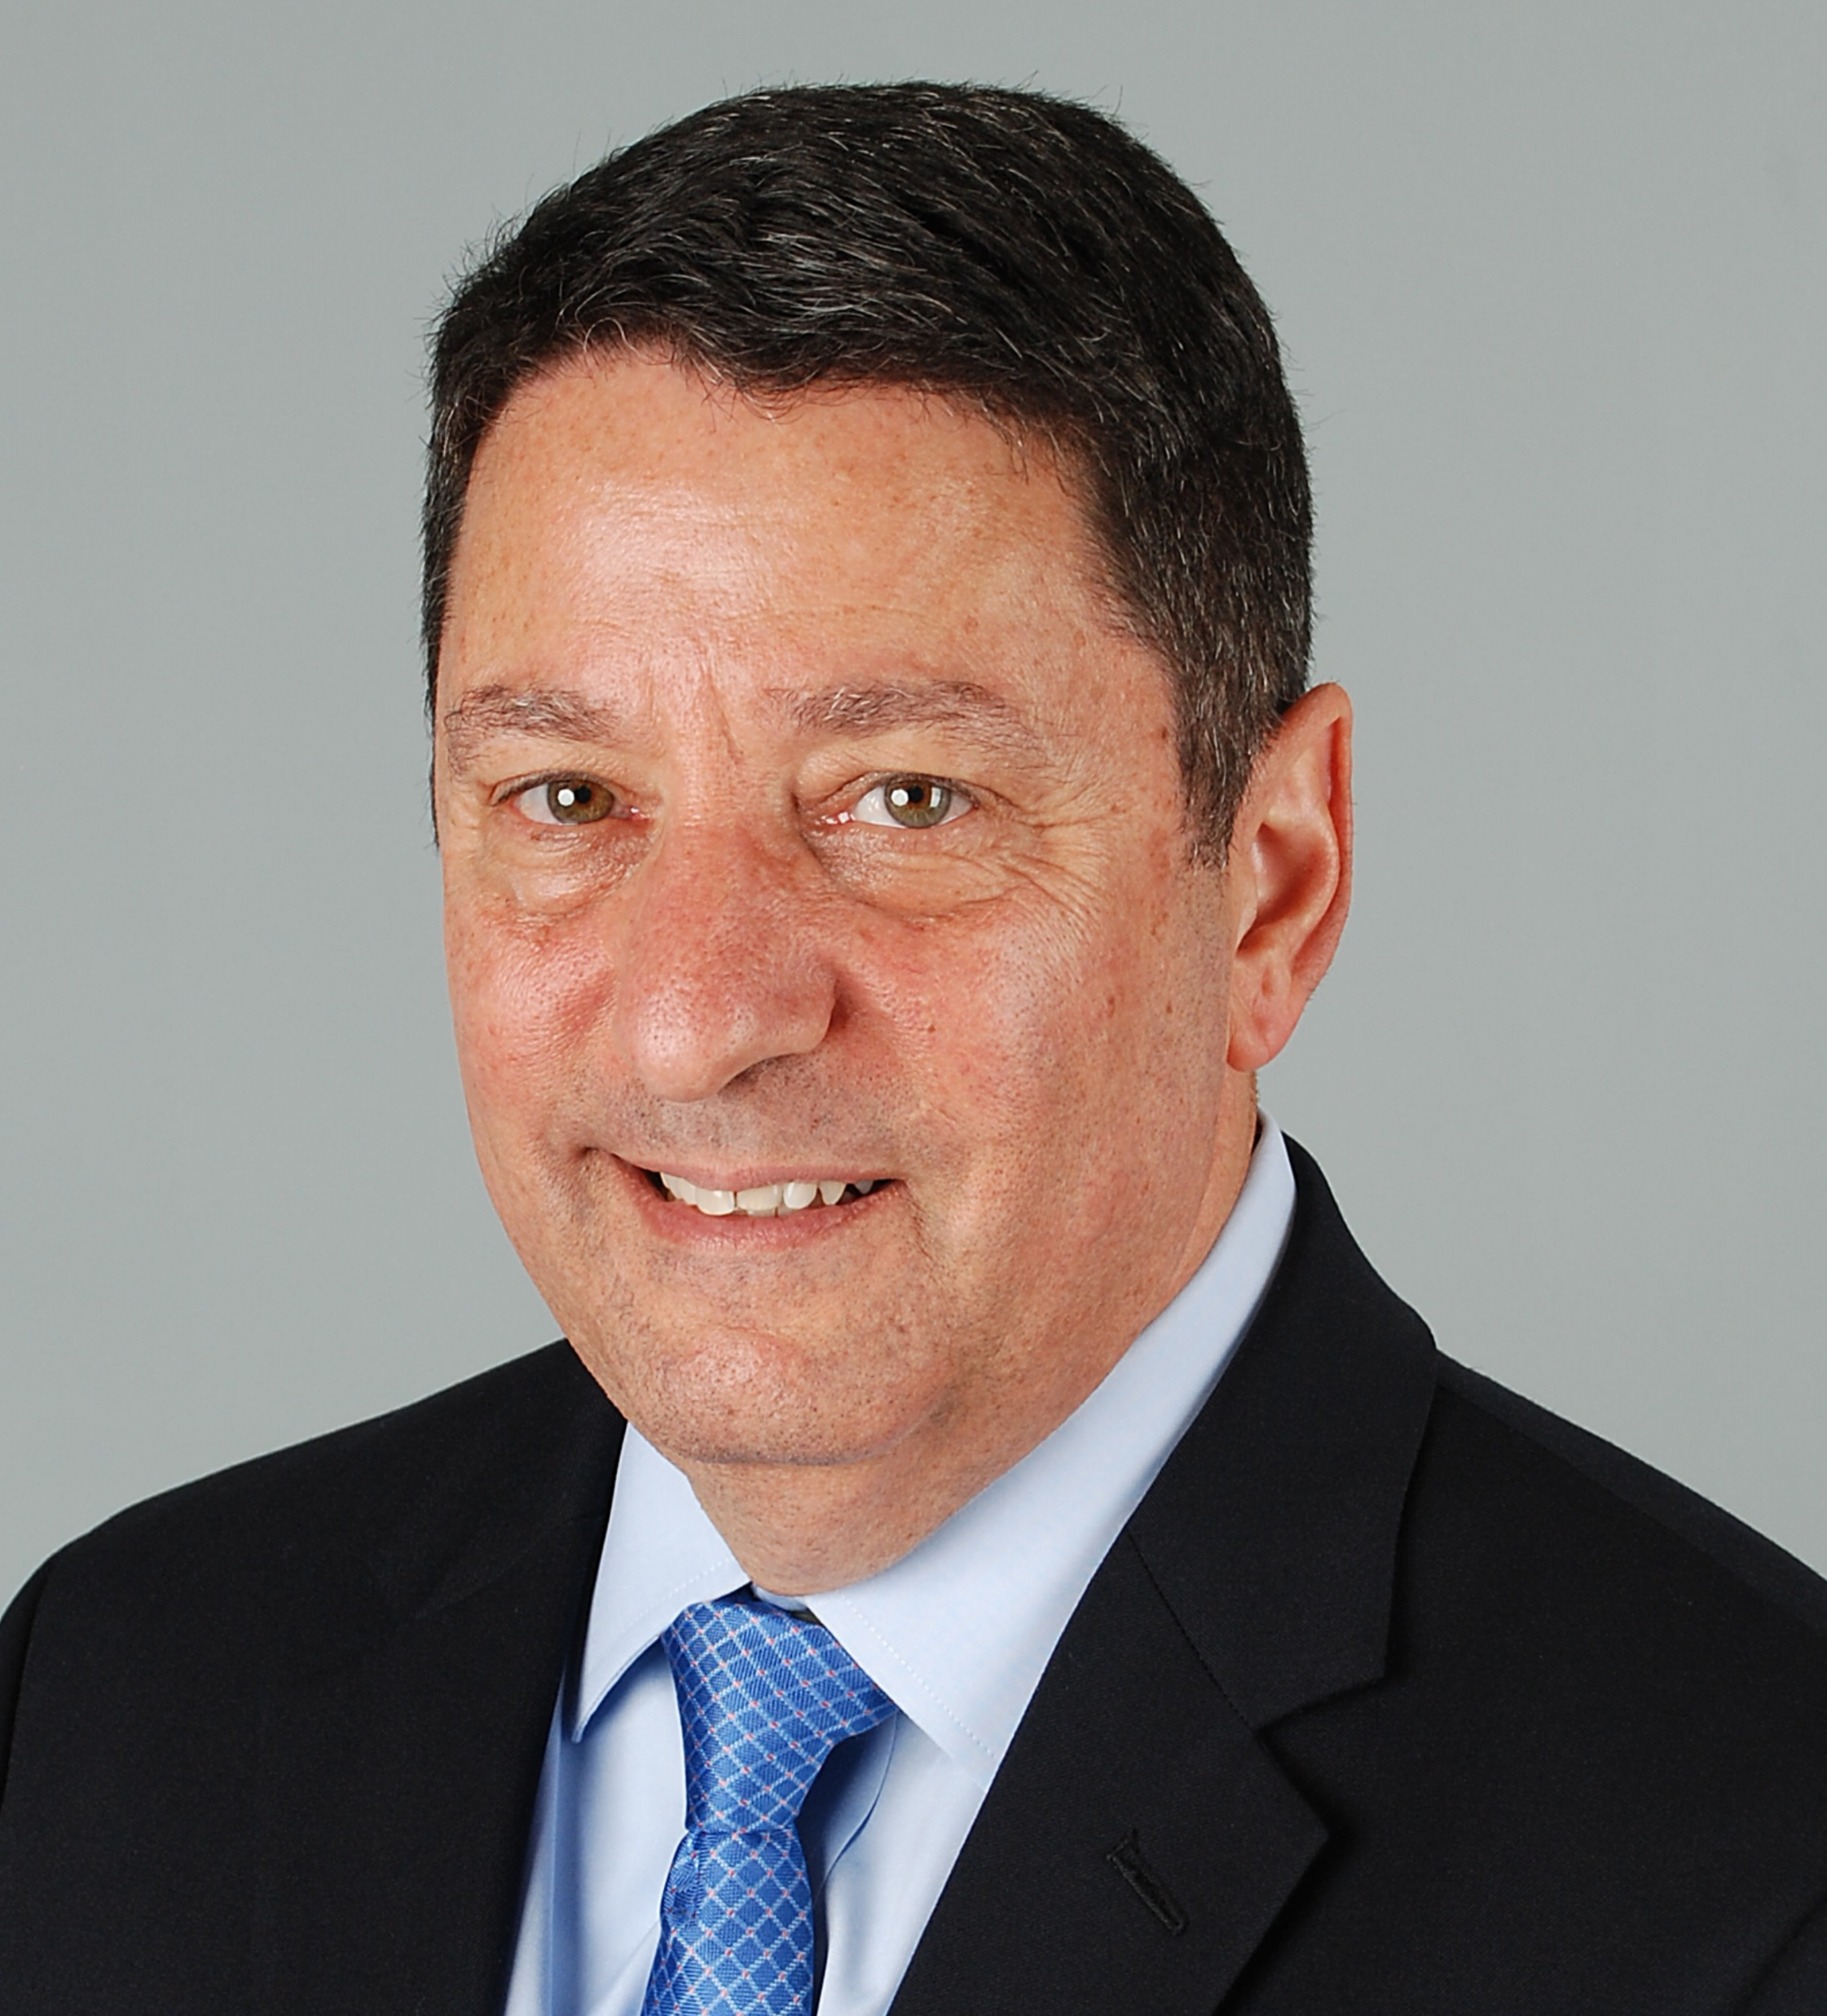
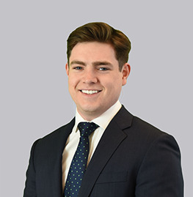
Contact Information
Jeff Megar, CFA
VP, Client Portfolio Solutions & Business Development
617-939-4526
jmegar@newfrontieradvisors.com
Mac Nicholson
Regional Consultant
617-849-8889
mnicholson@newfrontieradvisors.com
Notes:
Offering for Envestnet clients (Cetera)

Slide 26
Q&A
Notes:
Thank you for your attention and engagement today. We’d love to answer any questions you have

Slide 27
Thank You

Slide 28
Important Information
The calculations used in this report assume that all exchange-traded funds (“ETFs”) in the portfolio are bought and sold at the publicly available closing prices on the day of trading. Dividend reinvestment calculation occurs on the dividend ex-date. Rebalancing occurs on the historically recorded rebalance date of each strategy as archived by New Frontier.
The amount of gains and distributions displayed here does not reflect the deduction of any fees or expenses beyond ETF expense ratios including strategist, platform, custodial, or advisory fees. As a result, the gains do not show the compounding effect of those fees and expenses over time. As such, this report is not intended to, and cannot be used to, evaluate the actual performance of a model portfolio. To view performance data for New Frontier’s model portfolios, use https://frontieradvisor.com/analytics/.
This report is only designed to illustrate the estimated tax liability and other related questions that would be associated with estimated amounts of gains and distributions and is hypothetical in nature. The information provided is for informational purposes only and does not constitute tax advice. Investors should consult with a tax advisor regarding the tax implications of any investment decision. Tax savings results will vary for each investor based upon their specific circumstances and tax brackets.
For instructional purposes only. Past performance is not a guarantee of future returns. Any further distribution must comply with your firm’s guidelines and applicable rules and regulations, including Rule 206(4)-1 under the Investment Advisers Act of 1940.
Financial instruments discussed here may not be suitable for all investors. Before investing in any investment portfolio, the Client and Financial Advisor should carefully consider the client’s investment objectives, time horizon, risk tolerance, and fees. The Financial Advisor assumes full responsibility for determining the suitability and fitness of each portfolio for their clients. Diversification may not protect against market risk. There are risks involved in investing, including possible loss of principal. Past performance does not guarantee future results.
Visit newfrontieradvisors.com to learn more about our investment process and explore our latest Insights.
ABOUT NEW FRONTIER
New Frontier is an investment technology and management firm founded in 1999, specializing in optimizing customized portfolios. Our proprietary technologies, Michaud Optimization™ and Intelligent Rebalancing™, create market-adaptive, risk-managed portfolios. As an ETF strategist pioneer, we have a 20-year track record optimizing portfolios.
newfrontieradvisors.com / (617) 648-1433 / 155 Federal Street, Boston, MA 02110

Slide 29
Disclosures:
This information is for information purposes only. It does not constitute an offer or solicitation of securities or investment services or an endorsement thereof in any jurisdiction or in any circumstance in which such offer or solicitation is unlawful or not authorized. None of the information contained in this report constitutes, or is intended to constitute, a recommendation of any particular security or trading strategy or a determination by New Frontier that any security or trading strategy is suitable for any specific person. To the extent any of the information contained herein may be deemed to be investment advice, such information is impersonal and is not tailored to the investment needs of any specific person. All investments carry a risk of loss, including the possible loss of principal. There is no assurance that any investment will be profitable.
New Frontier Advisors, LLC (“New Frontier”) is retained as a portfolio strategist (“Strategist”) to provide model portfolios. Model portfolios are provided either (1) to registered investment advisors or broker-dealers (“Financial Advisors”) through third-party asset management platforms (“Sponsors”) or (2) to individual clients where New Frontier acts as subadvisor to the client’s Financial Advisor and accesses the client’s account through a qualified custodian (“Custodian”) to execute the model portfolio’s transactions. New Frontier does not provide investment advisory services tailored to the individual needs and objectives of any investor. New Frontier acts solely as subadvisor, strategist, model provider, and/or model manager, and its relationship with any investor is limited to a subadvisory role working with the investor’s Financial Advisor. Investors should consult with their Financial Advisor if they have any questions concerning the information provided here.

Slide 30
Disclosures:
Returns shown here for the Standard and MAI portfolios are hypothetical because the returns are from accounts following our models and represent our performance on one or more Sponsor Platforms. We include no back tested performance. The returns displayed here do not reflect the deduction of any fees or expenses beyond ETF expense ratios including strategist, platform, custodial, or advisory fees. As a result, the returns do not show the compounding effect of those fees and expenses over time. As such, this illustration is not intended to, and cannot be used to, evaluate the actual performance of a model portfolio. The calculations used in this document assume that all exchange-traded funds (“ETFs”) in the portfolio are bought and sold at the publicly available closing prices on the day of trading. Dividend reinvestment calculation occurs on the dividend ex-date. This report is only designed to illustrate the estimated difference in returns in the case studies and is hypothetical in nature.
Past performance is no guarantee of future results. The portfolio’s investment objective, risks, fees, and underlying expenses should be considered carefully before investing. As market conditions fluctuate, the investment return and principal value of any investment will change. Diversification may not protect against market risk. There are risks involved with investing, including possible loss of principal. Volatility represents the expected risk of the portfolio relative to major asset classes. The underlying holdings may invest in foreign and emerging market securities which will involve greater volatility as well as political, economic, and currency risks and differences in accounting methods. Portfolio holdings, exposures, and characteristics are as of the date show and are subject to change at any time. Before investing in any investment portfolio, the investor and Financial Advisor should carefully consider the investor’s investment objectives, time horizon, risk tolerance, and fees. The Financial Advisor assumes full responsibility for determining the suitability and fitness of each portfolio for their clients.

Slide 31
Disclosures:
These materials are prepared for financial professionals. Please note that any further distribution of these materials must comply with your firm’s marketing guidelines as well as applicable rules and regulations. This includes policies and procedures satisfying the SEC’s Marketing Rule that specifies that hypothetical performance can only be shared with end clients if is relevant to the likely financial situations and investment objectives of the intended audience. To receive additional information such as the New Frontier’s Disclosure Brochure (the Form ADV Part 2A), please contact updates@newfrontieradvisors.com.

