Slide 1
Behind the Curtain:
Investment Process and Case Studies
Exploring Our Process and the Impact of some Investment Scenarios
Robert Michaud David Esch
Presented on May 1, 2025
Confidential and Proprietary. For Institutional Use Only – © New Fronter Advisors LLC

Slide 2
Outline
Investment principles
Case study
Technology preview

Slide 3
Investment Principles

Slide 4
Investment principles and theory
Institutional framework
  Be conservative in assumptions
  Invest over time
  Estimate risk and return and invest accordingly
  Deliver the portfolio that’s most optimal for your goal today
Consequences
  Avoid big jumps and bets
We will examine several different hypothetical scenarios
  Market shifts
  Modifications to the investment universe

Slide 5
Philosophy
Avoid discredited investing practices
Apply provably beneficial practices

Slide 6
What We Avoid is Important
Predict the future
  Expert predictions of the S&P are worse than random chance.
Pick favorite stocks
  Stock pickers can underperform monkeys (Hsu and Kalesnik 2014).
Pick favorite mutual funds
  After fees, there’s very little persistence in top performing funds.
Pick favorite asset class
  E.g. periodic table of the asset class returns
Time markets
  Tactical managers often fail to avoid market downturns.

Slide 7
Beneficial Practices
Seek to maximize return and especially minimize risk
Balance risk and return
Diversification
Securities Geographical regions
Asset classes Time (intertemporal risk management)
Risk factors Asset Managers
Managing Costs
Limit turnover
Low cost ETFs
Manage taxes
Strategic but not static forecasts
Use currently available data
Avoid speculation
Optimize portfolios
Build portfolios for investor objectives

Slide 11
Why Optimize?
Stocks
Return
Bonds
Risk

Slide 12
Why Isn’t Everyone Optimizing
Theoretically correct
Practically unusable for investment solutions
Common practices
  Min variance or tax optimization
  Constrain solutions
  Avoid optimization entirely

Slide 13
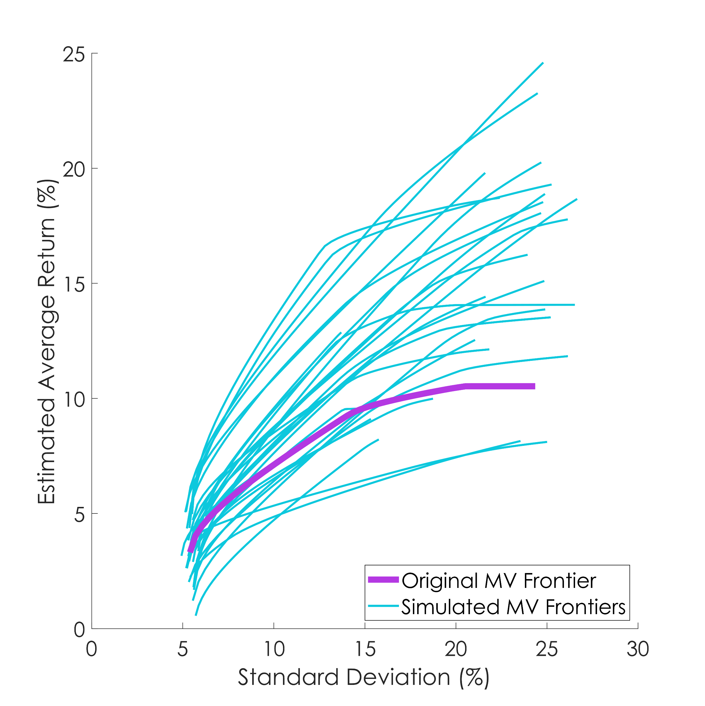
Understanding Portfolio Uncertainty
Original and Simulated MV Frontiers
Original and Simulated MV Frontiers
Start with your risk-return estimates and compute the Markowitz frontier (red curve)
Simulate new inputs and compute a new efficient frontier (cyan)
Do this many times
Each simulated frontier as optimal as any other by construction
Thousands of possible optimal asset allocations
Thousands of ways things can happen consistent with what you believe
Notes:
The graph is designed to convey the enormous sensitivity of Markowitz mean-variance optimization to uncertainty in investment information. The red curve is the Markowitz efficient frontier for a given set of data. The remaining curves are simulated Markowitz efficient frontiers based on simulations of the risks and returns from the original market outlook data.
Historically stocks beat bonds 70% of the time. This means that this forecast is wrong 30% of the time. An analyst may have an opinion on value versus growth, small versus large, treasuries versus corporate. But investors are not always right about what will happen. Asset allocations have many ways to be wrong and as a result there are many possible Markowitz efficient frontiers.
So how to average these possible efficient frontiers to get a good answer?

Slide 14
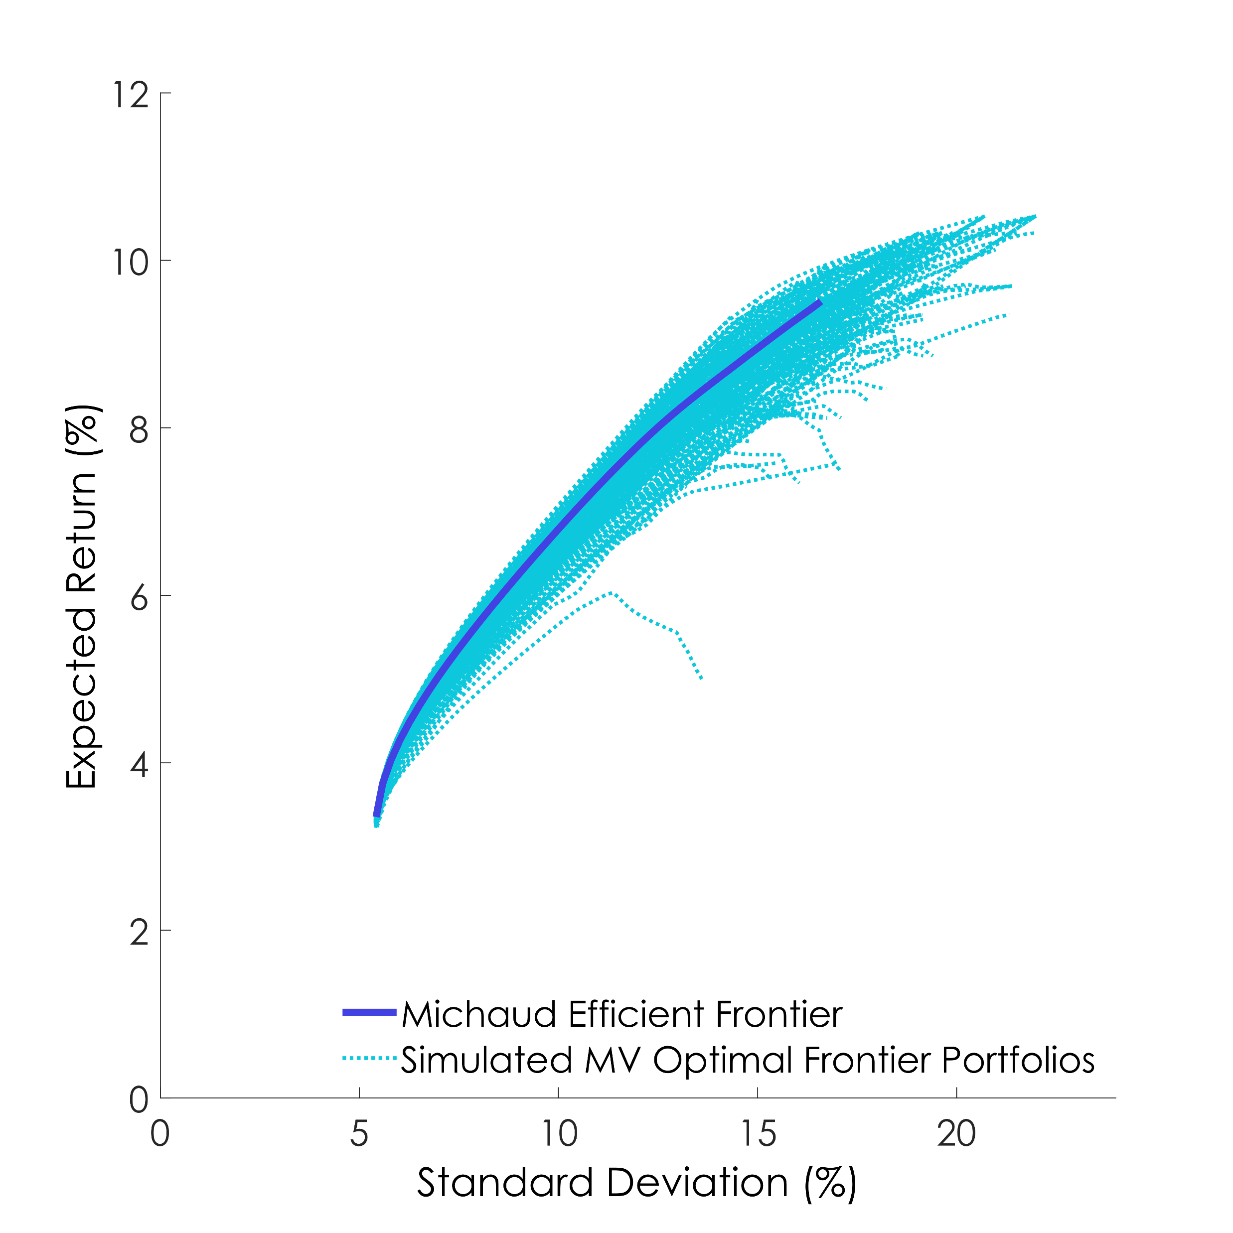
The Michaud Efficient Frontier
Harvard 1998, (OUP 2008, 2nd ed.), U.S. Patent 6,003,018
Michaud Resampled Efficient Frontier and Simulated Efficient Portfolios
U.S. patented averaging process
Optimal allocations relative to thousands of investment scenarios
Includes tail risks, fat tails, downside risk, black swans, periods when bonds beat stocks, etc.
A New efficient Frontier
Notes:
This slide represents the solution we invented. We patented an averaging process that leads to a single efficient frontier different from Markowitz. It includes all the many ways things can happed that are consistent with our best estimate of the future.

Slide 15
Simulated Outcomes

Slide 16
Case Study

Slide 17
A Current Case: Assets and Estimates
Current hypothetical estimates of Means, Standard Deviations, and Correlations of a pool of asset classes to use in Global Standard Optimizer
Purely Hypothetical – we don't use all of these assets
Process Combines
  Historical Estimation (with noise reduction),
  Current Information (e.g. T-Bill rate = 5.33%)
  Financial Structural Knowledge
Data Sources: Bloomberg, US Bureau of Labor Statistics, New Frontier Estimation Process

Slide 18
Assets and Estimates: Fixed Income
Asset | Mean | Standard Deviation
Cash | 3.8% | 0.6%
Floating Rate Bonds | 4.0% | 0.6%
Short Treasuries | 3.9% | 1.6%
Intermediate Treasuries | 4.2% | 4.7%
Long Treasuries | 4.8% | 11.8%
TIPS | 4.8% | 5.0%
Corporate | 5.3% | 7.8%
Long Corporate | 5.6% | 10.6%
Mortgage Backed | 4.2% | 3.9%
International Treasuries | 3.8% | 8.8%
Short High Yield | 7.6% | 7.3%
High Yield | 7.2% | 9.6%
Emerging Bonds | 6.6% | 10.0%
Data Sources: Bloomberg, US Bureau of Labor Statistics, New Frontier Estimation Process
Notes:
Reduced Std Dev of TFLO
Non-Inverted Duration Curve
TIPS between Int – Long Treas
Treas – IG – HY ladder
Also Correlation Matrix

Slide 19
Assets and Estimates: Equities and Alts
Asset | Mean | Standard Deviation
US Large Cap Value | 9.6% | 14.7%
US Large Cap Growth | 9.6% | 18.1%
US Small Cap Value | 10.0% | 18.8%
US Small Cap Growth | 10.2% | 21.7%
US Minimum Volatility | 9.4% | 12.0%
EAFE Min Vol | 8.6% | 12.0%
Canada | 9.0% | 19.3%
Europe | 9.7% | 18.4%
Switzerland | 9.1% | 15.8%
Pacific | 8.5% | 15.7%
International Small Cap | 9.6% | 19.2%
Emerging Markets | 9.8% | 18.6%
China | 9.4% | 26.3%
Gold | 4.7% | 16.1%
US REITs | 8.3% | 20.1%
International REITs | 8.4% | 18.3%
Data Sources: Bloomberg, US Bureau of Labor Statistics, New Frontier Estimation Process
Notes:
US Equities dominant
SC higher risk, return
Min Vol
EAFE Min Vol

Slide 20
We will examine
Scenario: Lower Interest Rates
How we model interest rates
The impact of a scenario change on these asset estimates
What happens to the portfolio weights generated by the Optimizer
This is an illustration only of a complex process and how small changes to an input can have ripple effects through the whole portfolio

Slide 21
Interest Rates Fall
Scenario: T-Bill rate falls 1 percentage point
Impact on Other Fixed Income
Impact on Equities
Other impacts
How it changes the portfolios

Slide 22
How we Model Optimizer Inputs
Combine Information from
  Historical Market Data – Co-movement of asset returns
  Current Information – Fixed Income Yields, Geopolitical relations, Market regimes
    Expressed as Views on portfolios of assets
  Structural Market Information (e. g. Stocks beat Bonds)
    Also expressed as Views on baskets of assets
    Often one basket contrasted against another
  Statistical Estimation Process Combines all of the above

Slide 23
How we Model Interest Rates
Risk-Free rate – component of all estimated returns
Market Portfolio Forecast – view gets adjusted up or down depending on value. Mathematical formula shrinks Equity Premia based on RFR.
Views on other Fixed Income Assets directly modified by changes in yield curve
  Often based on differences in yield curve values
Impact on all assets propagated through correlations – “side effects”
Revised risk and return estimates affect resampling process

Slide 24
Current hypothetical RFR: 3.84%
Scenario: lowered to 2.84%
Fixed Income Impact
Asset | Old Mean | New Mean | Difference | Standard Deviation
Cash | 3.8% | 3.0% | -0.8% | 0.6%
Floating Rate Bonds | 4.0% | 3.2% | -0.8% | 0.6%
Short Treasuries | 3.9% | 3.7% | -0.2% | 1.6%
Intermediate Treasuries | 4.2% | 3.4% | -0.8% | 4.7%
Long Treasuries | 4.8% | 4.0% | -0.8% | 11.8%
TIPS | 4.8% | 4.1% | -0.7% | 5.0%
Corporate | 5.3% | 5.3% | 0.0% | 7.8%
Long Corporate | 5.6% | 5.5% | -0.1% | 10.6%
Mortgage Backed | 4.2% | 3.6% | -0.6% | 3.9%
International Treasuries | 3.8% | 3.4% | -0.4% | 8.8%
Short High Yield | 7.6% | 7.0% | -0.6% | 7.3%
High Yield | 7.2% | 6.7% | -0.5% | 9.6%
Emerging Bonds | 6.6% | 6.1% | -0.5% | 10.0%
Floating Rate Bonds down relative to Short Treasurys (correlations)
Corporates less impacted, HY Down
Data Sources: Bloomberg, US Bureau of Labor Statistics, New Frontier Estimation Process
Notes:
Point out difference between TFLO and Short Treasuries

Slide 25
“Current” RFR: 3.84%
Scenario: lowered to 2.84%
Equity and Alt Impact
Asset | Old Mean | New Mean | Difference | Standard Deviation
US Large Cap Value | 9.6% | 8.8% | -0.8% | 14.7%
US Large Cap Growth | 9.6% | 8.8% | -0.8% | 18.1%
US Small Cap Value | 10.0% | 9.3% | -0.7% | 18.8%
US Small Cap Growth | 10.2% | 9.4% | -0.8% | 21.7%
US Minimum Volatility | 9.4% | 8.5% | -0.9% | 12.0%
EAFE Min Vol | 8.6% | 8.0% | -0.6% | 12.0%
Canada | 9.0% | 8.5% | -0.5% | 19.3%
Europe | 9.7% | 9.3% | -0.4% | 18.4%
Pacific | 8.5% | 7.5% | -1.0% | 15.7%
International Small Cap | 9.6% | 8.8% | -0.8% | 19.2%
Emerging Markets | 9.8% | 9.3% | -0.5% | 18.6%
Gold | 4.7% | 4.8% | 0.1% | 16.1%
US REITs | 8.3% | 7.7% | -0.6% | 20.1%
International REITs | 8.4% | 7.8% | -0.6% | 18.3%
US, Developed Equities down
Gold unaffected
REITs down
Data Sources: Bloomberg, US Bureau of Labor Statistics, New Frontier Estimation Process
Notes:
Point out difference between TFLO and Short Treasuries

Slide 26
Current Portfolios (left) vs. Reduced Rate Portfolios (right)
Current Rate Portfolios
 | 20/80 | 40/60 | 60/40 | 75/25 | 90/10 | 100/0
Cash | 2.0% | 2.0% | 2.0% | 2.0% | 2.0% | 2.0%
Floating Rate Treasurys | 20.6% | 10.7% | 4.8% | 1.8% | 0.3% | 0.0%
Treasurys | 34.7% | 24.2% | 12.9% | 6.6% | 1.5% | 0.0%
IG | 1.9% | 3.8% | 4.3% | 2.7% | 0.8% | 0.0%
HY | 12.6% | 11.6% | 10.1% | 7.9% | 3.9% | 0.0%
Other Bonds | 6.5% | 4.7% | 3.3% | 2.3% | 0.9% | 0.0%
US Large Cap | 5.8% | 12.4% | 21.7% | 30.3% | 39.4% | 42.0%
US Small Cap | 2.0% | 5.0% | 7.5% | 9.2% | 11.4% | 14.5%
Min Vol | 8.4% | 10.1% | 8.4% | 5.9% | 2.7% | 0.5%
Developed | 2.1% | 6.7% | 12.4% | 16.9% | 21.7% | 25.7%
EM | 1.3% | 3.8% | 6.1% | 7.6% | 9.0% | 9.4%
Gold | 1.7% | 3.1% | 2.5% | 1.6% | 0.5% | 0.0%
REITs | 0.4% | 2.0% | 4.0% | 5.2% | 5.9% | 5.8%
Reduced Rate Portfolios
 | 20/80 | 40/60 | 60/40 | 75/25 | 90/10 | 100/0
Cash | 2.0% | 2.0% | 2.0% | 2.0% | 2.0% | 2.0%
Floating Rate Treasurys | 8.0% | 2.5% | 1.0% | 0.4% | 0.1% | 0.0%
Treasurys | 43.9% | 28.7% | 14.0% | 6.5% | 1.4% | 0.0%
IG | 3.4% | 6.7% | 6.7% | 4.3% | 1.3% | 0.0%
HY | 13.5% | 12.0% | 10.3% | 7.9% | 3.8% | 0.0%
Other Bonds | 7.0% | 4.6% | 3.1% | 2.1% | 0.9% | 0.0%
US Large Cap | 6.2% | 12.5% | 21.6% | 30.0% | 38.9% | 41.6%
US Small Cap | 2.1% | 5.0% | 7.4% | 9.1% | 11.3% | 14.3%
Min Vol | 7.7% | 9.2% | 7.6% | 5.3% | 2.5% | 0.4%
Developed | 2.1% | 6.7% | 12.6% | 17.2% | 21.9% | 26.0%
EM | 1.5% | 4.2% | 6.6% | 8.1% | 9.5% | 9.8%
Gold | 2.2% | 3.8% | 3.0% | 1.8% | 0.6% | 0.0%
REITs | 0.4% | 2.1% | 4.1% | 5.3% | 6.0% | 5.9%
Data Sources: Bloomberg, US Bureau of Labor Statistics, New Frontier Estimation Process

Slide 27
Impact of Rate Change Scenario
Float – Fixed Treasury Tradeoff – Float less valuable in lower rate environment
IG more attractive
HY slightly more attractive
Alts more attractive means less total weight in FI and Equities
 | 2080 | 4060 | 6040 | 7525 | 9010 | 1000
Cash | 0.0% | 0.0% | 0.0% | 0.0% | 0.0% | 0.0%
Floating Rate Treasurys | -12.6% | -8.2% | -3.7% | -1.4% | -0.2% | 0.0%
Treasurys | 9.2% | 4.5% | 1.1% | -0.1% | -0.2% | 0.0%
IG | 1.5% | 2.8% | 2.4% | 1.6% | 0.5% | 0.0%
HY | 0.9% | 0.4% | 0.2% | 0.1% | 0.0% | 0.0%
Other Bonds | 0.5% | -0.1% | -0.2% | -0.2% | -0.1% | 0.0%
US Large Cap | 0.4% | 0.1% | -0.1% | -0.3% | -0.5% | -0.4%
US Small Cap | 0.1% | 0.0% | -0.1% | -0.1% | -0.2% | -0.2%
Min Vol | -0.7% | -0.9% | -0.8% | -0.6% | -0.3% | -0.1%
Developed | 0.0% | 0.0% | 0.2% | 0.3% | 0.3% | 0.3%
EM | 0.2% | 0.4% | 0.5% | 0.5% | 0.5% | 0.4%
Gold | 0.5% | 0.7% | 0.4% | 0.3% | 0.1% | 0.0%
REITs | 0.1% | 0.1% | 0.1% | 0.1% | 0.1% | 0.0%
Data Sources: Bloomberg, US Bureau of Labor Statistics, New Frontier Estimation Process

Slide 28
Summary
These scenarios are for illustration and are not fully rendered investment portfolios!
Every change to the inputs has consequences across the whole portfolio
Sometimes these consequences must be managed
New Frontier's investment process is an interconnected model of how the assets behave together

Slide 29
Q&A

Slide 30
Disclosures:
This information is for information purposes only. It does not constitute an offer or solicitation of securities or investment services or an endorsement thereof in any jurisdiction or in any circumstance in which such offer or solicitation is unlawful or not authorized. None of the information contained in this report constitutes, or is intended to constitute, a recommendation of any particular security or trading strategy or a determination by New Frontier that any security or trading strategy is suitable for any specific person. To the extent any of the information contained herein may be deemed to be investment advice, such information is impersonal and is not tailored to the investment needs of any specific person. All investments carry a risk of loss, including the possible loss of principal. There is no assurance that any investment will be profitable.
New Frontier Advisors, LLC (“New Frontier”) is retained as a portfolio strategist (“Strategist”) to provide model portfolios. Model portfolios are provided either (1) to registered investment advisors or broker-dealers (“Financial Advisors”) through third-party asset management platforms (“Sponsors”) or (2) to individual clients where New Frontier acts as subadvisor to the client’s Financial Advisor and accesses the client’s account through a qualified custodian (“Custodian”) to execute the model portfolio’s transactions. New Frontier does not provide investment advisory services tailored to the individual needs and objectives of any investor. New Frontier acts solely as subadvisor, strategist, model provider, and/or model manager, and its relationship with any investor is limited to a subadvisory role working with the investor’s Financial Advisor. Investors should consult with their Financial Advisor if they have any questions concerning the information provided here.

Slide 31
Disclosures:
Past performance is no guarantee of future results. The portfolio’s investment objective, risks, fees, and underlying expenses should be considered carefully before investing. As market conditions fluctuate, the investment return and principal value of any investment will change. Diversification may not protect against market risk. There are risks involved with investing, including possible loss of principal. Volatility represents the expected risk of the portfolio relative to major asset classes. The underlying holdings may invest in foreign and emerging market securities which will involve greater volatility as well as political, economic, and currency risks and differences in accounting methods. Portfolio holdings, exposures, and characteristics are as of the date show and are subject to change at any time. Before investing in any investment portfolio, the investor and Financial Advisor should carefully consider the investor’s investment objectives, time horizon, risk tolerance, and fees. The Financial Advisor assumes full responsibility for determining the suitability and fitness of each portfolio for their clients.
These materials are prepared for financial professionals. Please note that any further distribution of these materials must comply with your firm’s marketing guidelines as well as applicable rules and regulations. This includes policies and procedures satisfying the SEC’s Marketing Rule that specifies that hypothetical performance can only be shared with end clients if is relevant to the likely financial situations and investment objectives of the intended audience. To receive additional information such as the New Frontier brochure (the Form ADV Part 2A), please contact updates@newfrontieradvisors.com

